Slide 1
Welcome

Slide 2
Linear Search

Slide 3
Bubble Sort

Slide 4
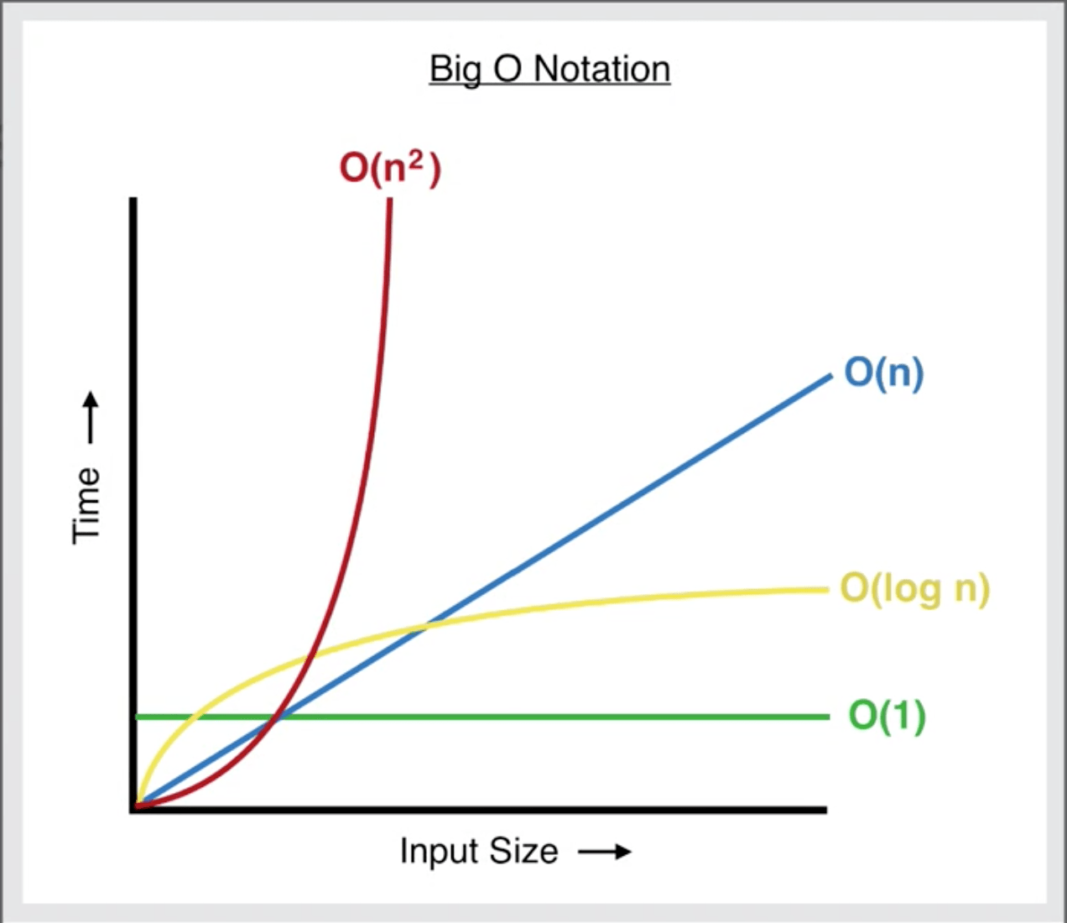
Big O Complexities
Image from: https://levelup.gitconnected.com/big-o-time-complexity-what-it-is-and-why-it-matters-for-your-code-6c08dd97ad59

Slide 5
Priority Queues
Output:

Slide 6
My Basic Implementation

